Slide 1

Exploratory Data Analysis (EDA) Automobile Data Set
Gaurav Virmani
29-Jun-20

Slide 2
Problem statement
When it comes to selling the car, we always look for getting the car best resale value. There are various reasons that's depreciate the value of used car.
The problem here is:
We don't know how much we should sell the car for
Want to set the reasonable price so that someone can purchase it
Let’s make use of Data Science and EDA to gain insights into the Automobile Data set and derive the model.

Slide 3
Data set
The Automobile Data set consists of following attributes:
1. symboling | 14. curb-weight
2. normalized-losses | 15. engine-type
3. make | 16. num-of-cylinders
4. fuel-type | 17. engine-size
5. aspiration | 18. fuel-system
6. num-of-doors | 19. bore
7. body-style | 20. stroke
8. drive-wheels | 21. compression-ratio
9. engine-location | 22. horsepower
10. wheel-base | 23. peak-rpm
11. length | 24. city-mpg
12. width | 25. highway-mpg
13. Height | 26. price

Slide 4
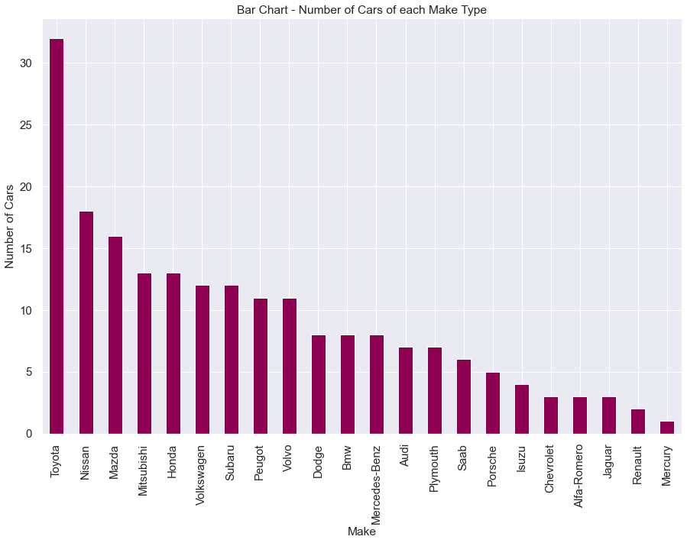
Exploratory Data analysis - Univariate Plotting
Question: How many cars are sold of each Make type?
Observations:
Top 3 manufactures are - Toyota, Nissan & Mazda
Toyota is the most preferred make with the highest number of cars, approx. 44% more than Nissan
Mercury make has the least number of cars

Slide 5
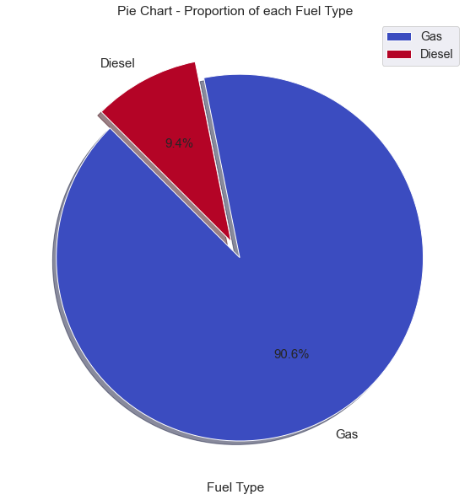
Exploratory Data analysis - Univariate Plotting
Question: What is the proportion of cars based on fuel type?
Observation:
Most preferred cars are of Gas fuel type with 91% proportion

Slide 6
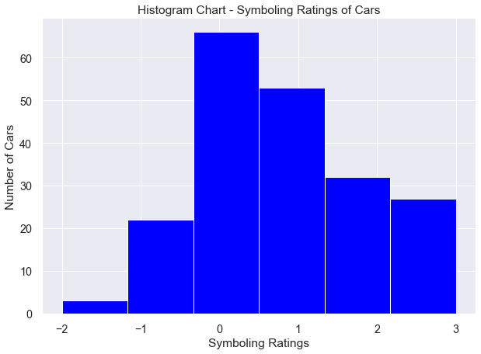
Exploratory Data analysis - Univariate Plotting
Question: What are Symboling Ratings of cars?
Observations:
Symboling Rating is a risk factor symbol associated with car prices. The value ranges from -3 to +3, with +3 indicates the vehicle is risky and -3 is the safest
Most of the cars are in the range of 0 and 1

Slide 7
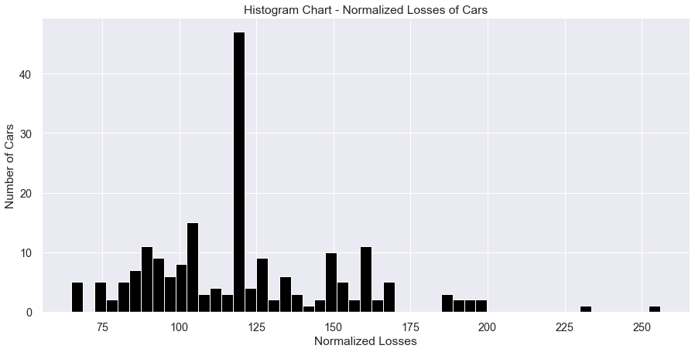
Exploratory Data analysis - Univariate Plotting
Question: What are Normalized Losses of cars?
Observations:
Normalized losses is the relative average loss payment per insured vehicle year
Most of the cars are in the range of 75 and 165

Slide 8
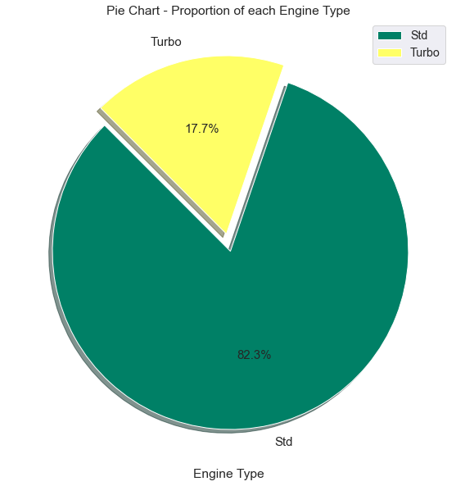
Exploratory Data analysis - Univariate Plotting
Question: What are the proposition of cars of each Engine Type?
Observation:
Most preferred cars are of Std type with 82% proportion

Slide 9
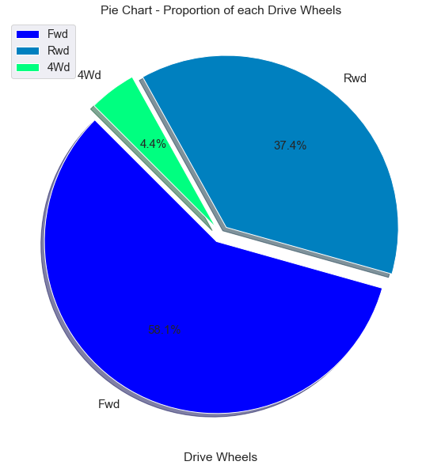
Exploratory Data analysis - Univariate Plotting
Question: What are the proposition of cars based on Drive Wheels?
Observations:
Front-wheel drive are the most number of cars with 58%
Rear-wheel drive cars are 37%
4-wheel drive has the least number of cars with 4%

Slide 10
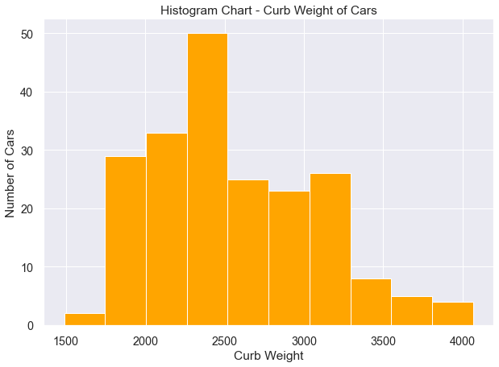
Exploratory Data analysis - Univariate Plotting
Question: What are the Curb Weight of cars?
Observation:
Curb Weight of cars is in range of 1500 and 4000

Slide 11
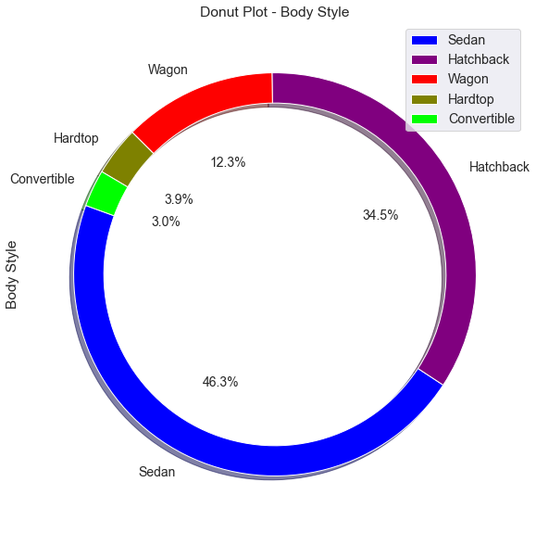
Exploratory Data analysis - Univariate Plotting
Question: Which is the most preferred car variant?
Observations:
Sedan followed by Hatchback body styles cars are most preferred
80% of the cars are of Sedan and Hatchback styles

Slide 12
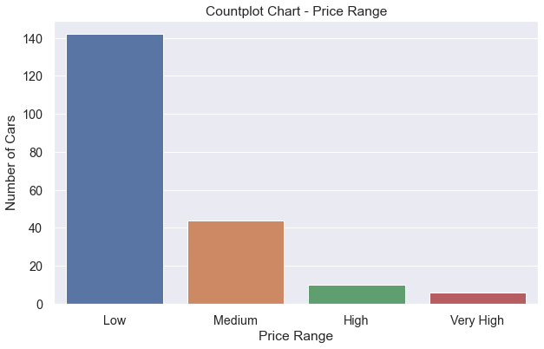
Exploratory Data analysis - Univariate Plotting
Question: How are the cars distributed in price range?
Observations:
70% cars are in Low price range
Less than 5% cars are in Very High price range

Slide 13
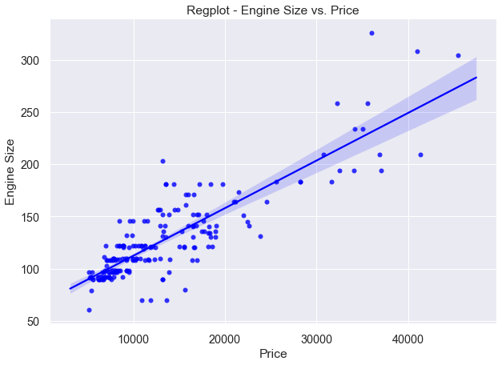
Exploratory Data analysis - bivariate Plotting
Question: How are Price and Engine Size related?
Observation:
As the Engine size goes up, price goes up too. This is Positive Linear relationship

Slide 14
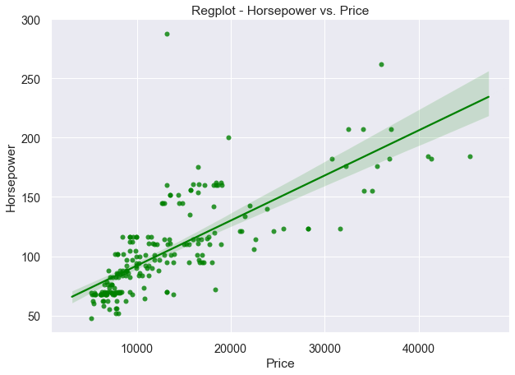
Exploratory Data analysis - bivariate Plotting
Question: How are Price and Horsepower related?
Observation:
As the Horsepower goes up, price goes up too. This is Positive Linear relationship

Slide 15
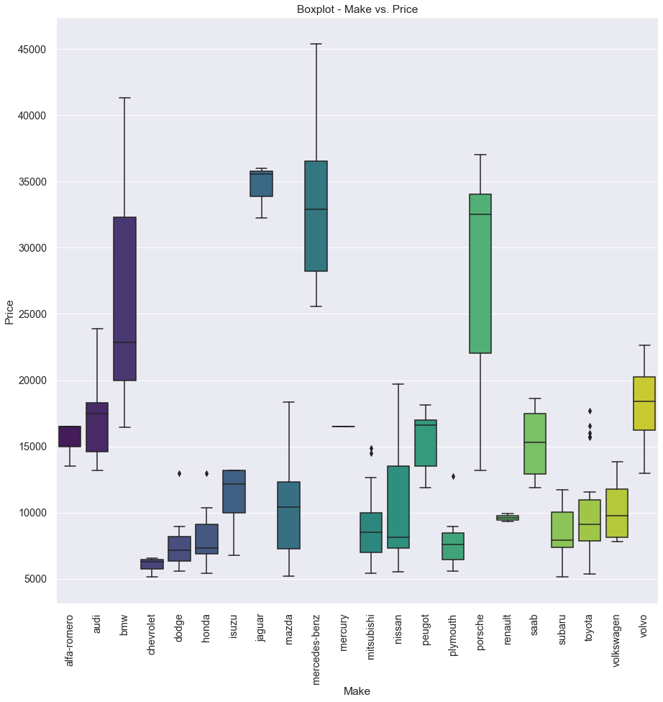
Exploratory Data analysis - multivariate Plotting
Question: What are the average prices of cars?
Observations:
Most expensive cars are of make Mercedes Benz and the least expensive are of Chevrolet make
Cars costing High i.e. more than 20000 are BMW, Jaguar, Mercedes Benz and Porsche
Cars costing less than 10000 are Chevrolet, Dodge, Honda, Mitsubishi, Plymouth and Subaru
Other cars are in the range between 10000 and 20000

Slide 16
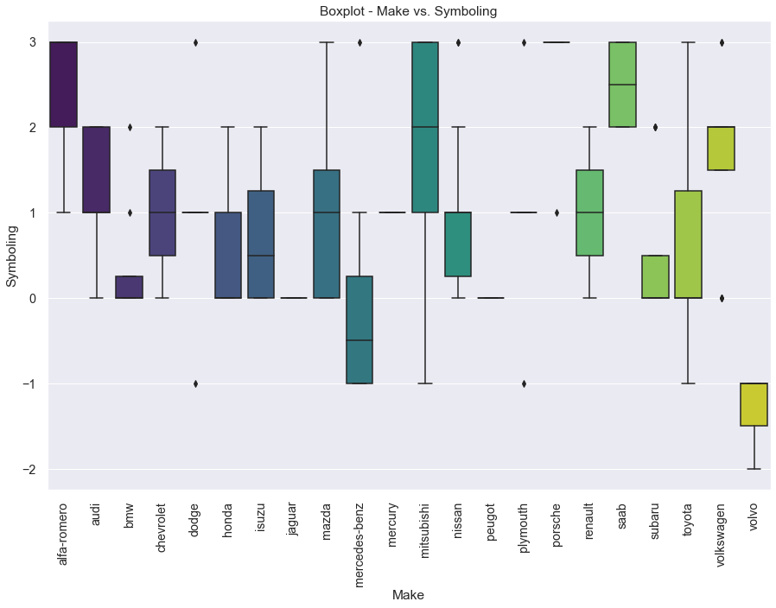
Exploratory Data analysis - multivariate Plotting
Question: Which brand of the car is the safest?
Observations:
Volvo manufactured cars are the safest and Mitsubishi manufactured cars are most dangerous
Not much Alfa-romero cars data is available, hence, difficult to comment

Slide 17
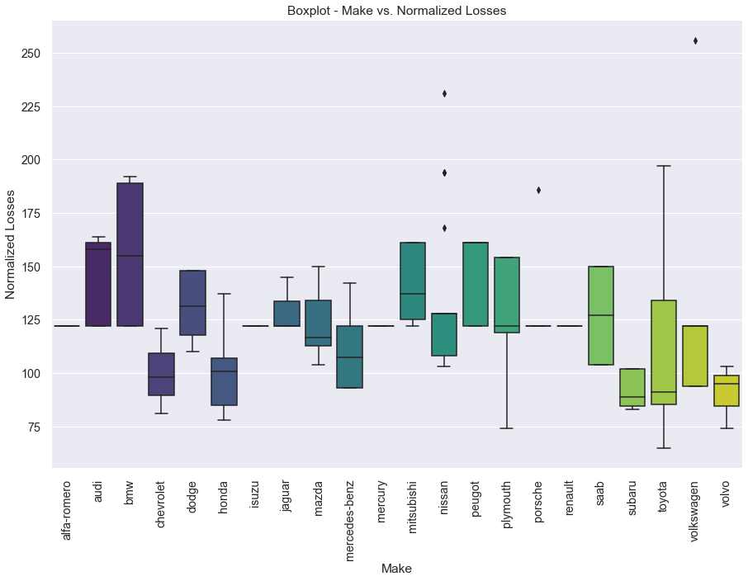
Exploratory Data analysis - multivariate Plotting
Question: Which car has more Normalized Losses?
Observations:
Toyota manufactured cars have lowest Normalized Losses with few outliers
BMW manufactured cars have highest Normalized Losses

Slide 18
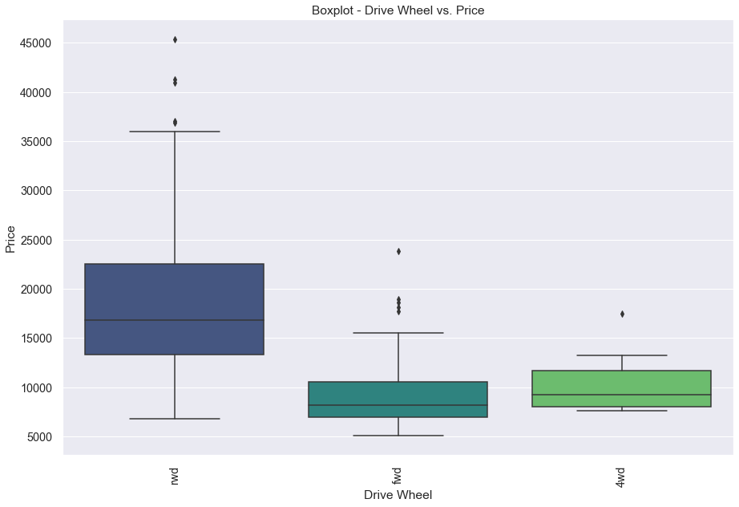
Exploratory Data analysis - multivariate Plotting
Question: Which type of drive wheel cars are expensive?
Observations:
Rear-wheel drive cars are most expensive and front-wheel drive cars are least expensive
More or less front-wheel and 4-wheel drive cars are of same prices

Slide 19
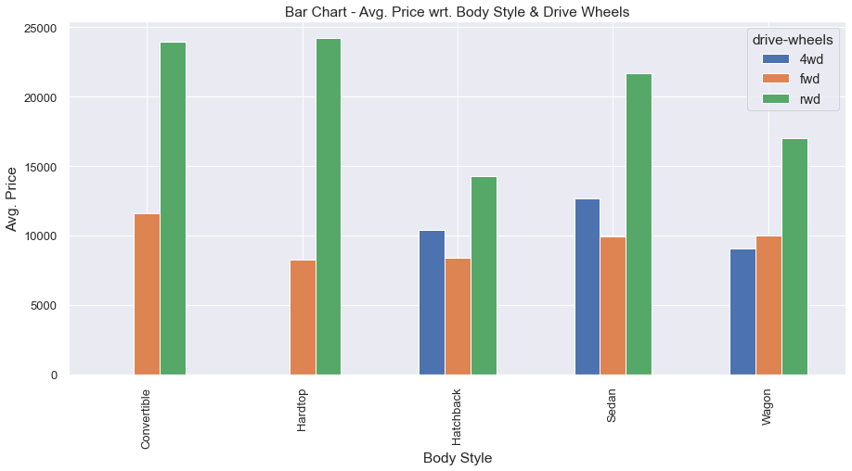
Exploratory Data analysis - multivariate Plotting
Question: Which type of drive wheel cars are expensive?
Observations:
There are no 4-wheel drive cars available in Convertible and Hardtop variants
Hatchback forward-wheel drive cars are the cheapest cars. Unfortunately, there is not much Hardtop forward-wheel drive data available, hence, difficult to comment
Rear-wheel drive cars are the expensive cars in all the variants

Slide 20
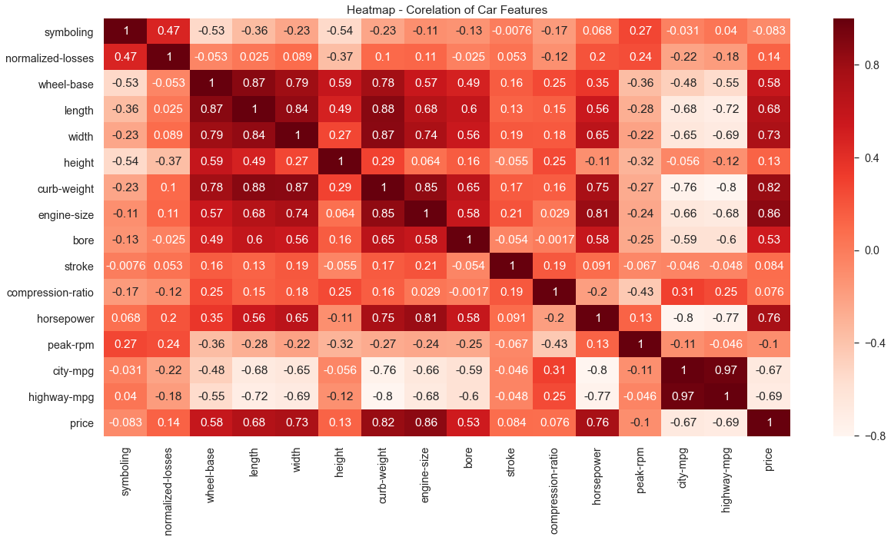
Exploratory Data analysis - multivariate Plotting
Question: How are other features of cars corelated?
Observations:
Price of the car is highly correlated with Engine Size and Curb Weight of the car
Curb Weight is calculated based on Length, Width and Wheel-base of the car which is obvious from the plot
Wheel-base is highly correlated with Length and Width of the car
Engine Size and Horsepower are highly correlated

Slide 21
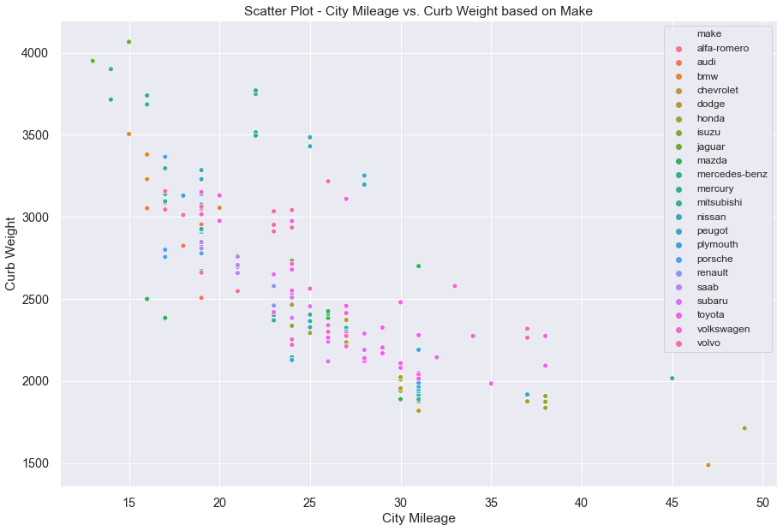
Exploratory Data analysis - multivariate Plotting
Question: How are City Mileage and Curb Weight related?
Observation:
City Mileage & Highway Mileage are inversely related to Curb Weight

Slide 22
conclusion
It is analyzed that there are features that are highly corelated with the cost of cars
Evident from the data that the analysis will help both seller and buyer to set the reasonable price
It is beneficial for the buyer to take decision to buy the kind of car at best price
Actionable Insights
Using EDA plots, there is good amount of information available with respect to variables relationship and the factors effecting the cost of the cars
The details can be used to build Machine Learning model and evaluate model prediction performance for calculating the resale cost of the cars

Slide 23
USEFUL LINKS
Data Source - https://github.com/insaid2018/Term-1/tree/master/Data/Projects
Dropbox Link - https://www.dropbox.com/request/Y6aCSSqW8Lyi6ryolNiC
References:
Color Maps - https://matplotlib.org/3.1.0/tutorials/colors/colormaps.html
Plots - https://matplotlib.org/3.1.0/tutorials/colors/colormaps.html
https://datavizproject.com/

Slide 24
Thank you

